Slide 1
ABOS Knowledge, Skills, and Behavior Program
ABOS KSB Program
Faculty and Staff

Slide 2
Background
Surgical Education Shift
Time-Based Competency-Based
Deficiencies exists in:
Documenting, following, and measuring competence.
The ABOS, representing the public interest, is providing a tool for greater documentation of surgical skills competence and professional behavior.

Slide 3
ABOS KSB Program
Knowledge
Measured by the Orthopaedic In-Training Examination.
Now linked to ABOS Part I
Surgical Skills
Measured by O-P Surgical Skills Assessment.
35 Tier 1 Core Orthopaedic Procedures & 53 Tier 2 Exposure Orthopaedic Procedures
Professional Behavior
Measured by ABOS Behavior Tool (ABOSBT) through assessment requests of attendings and other healthcare professionals.
5 Domains - ethics, communication, interaction, reliability, and self-assessment

Slide 4
How It Works
Residents are responsible for requesting assessments on surgical skills and professional behavior.
Faculty are responsible for completing the assessments.
Completed Surgical Skills assessments are sent back to the resident in real-time.
Professional Behavior feedback is redacted. Residents receive report at end of year.
Note: Scores below a certain threshold will receive a flag and PD has the discretion to address.

Slide 5
Interface
Smartphone-Optimized
The evaluator receives a text/email with a link to be taken to the assessment form.
Email is the default communication platform, if you prefer text message, please inform your program coordinator.
The assessment form is one question per page. Faculty using smartphones with dictation capability may dictate the feedback comments.

Slide 6
Method and Requirements
Surgical Skills Assessment Requests
PGY-2 – PGY-5 residents will each request at least two Surgical Skills Assessments per week.
PGY-1 residents may also request assessments if appropriate and desired by program director/faculty.

Slide 7
Methods and Requirements
Professional Behavior Assessment Requests
Residents are expected to request Professional Behavior assessments from all the faculty with whom they train on each rotation, near or at the end of each rotation.
360-Evaluation – Program Director requests an evaluation once a year and it offers multiple individuals from different environments the opportunity to evaluate resident performance.

Slide 8
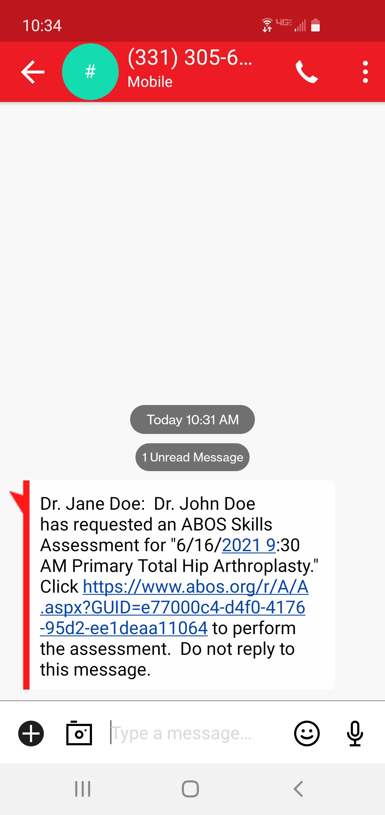
Email/Text Assessment Requests Look Like

Slide 9
Resident Requests Assessment
I have a list of 35 procedures that I need to be evaluated on. Can you evaluate my performance on the Primary Total Hip Arthroplasty we are going to do? I will send you a text at the end of the surgery.
Of course. I will be sure to make careful observations.

Slide 10
Surgical Procedures for Assessment
35 Total
53 Total

Slide 11
Surgical Procedures for Assessment

Slide 12
Surgical Procedures for Assessment

Slide 13
Faculty Receives Request
I just got a text/email from my resident to evaluate their performance on the surgery. This will be quick and easy, so I will complete it right now while I remember! The text links to a web-based evaluation.

Slide 14
5 Point Ottawa Surgical Competency Operating Room Evaluation (O-SCORE)
“I had to do”—i.e., Requires complete hands-on guidance, did not do, or was not given the opportunity to do.
“I had to talk them through”—i.e., Able to perform tasks but requires constant direction.
“I had to prompt them from time to time”—i.e., Demonstrates some independence, but requires intermittent direction.
“I needed to be in the room just in case”—i.e., Independence but unaware of risks and still requires supervision for safe practice.
“I did not need to be there”—i.e., Complete independence, understands risks and performs safely, practice ready.

Slide 15
Formative Evaluation Using O-Score for 8 Steps of Surgical Procedure
Pre-procedure plan: Gathers/assesses required information to reach diagnosis and determine correct procedure required.
Case preparation: Patient correctly prepared and positioned, describes approach and lists required instruments, prepared to deal with probable complications.
Knowledge of specific procedural steps: Can sequence steps of procedure, articulates potential risks, and means to avoid/overcome them.
Technical performance: Efficiently performs steps, avoiding pitfalls and respecting soft tissues.
Visuospatial skills: 3D spatial orientation and able to position instruments/hardware where intended.
Post-procedure plan: Appropriate complete post procedure plan.
Efficiency and flow: Obvious planned course of procedure with economy of movement and flow.
Communication: Professional and effective communication/utilization of staff.
Resident is able to safely perform this procedure independently (circle) Y N

Slide 16
Surgical Skills Assessment

Slide 17
5 Point Summative P-Tool (Procedure Assessment Tool)
-Comments Field: Feedback to residents including targeted areas for improvement:
Novice: Attending surgeon provides maximum assistance, Demonstrates knowledge of anatomy, Demonstrates basic operative skills (eg. incision, excision, wound closure), Positions patient, First assists and observes.
Advanced Beginner: Attending surgeon provides significant assistance and direction, Performs approach with minimal assistance, Identify anatomical landmarks, Identifies most of the critical steps, Demonstrates the component technical skills, Demonstrates an increasing ability to perform different key parts of the operation with attending assistance, Demonstrates room set up and equipment management.
High Intermediate: Attending provides modest assistance and direction, Capable of performing the approach, Familiar with anatomic landmarks, Identifies and is capable of performing almost all of the critical steps, Demonstrates advanced skills, Attending assistance required for the most challenging portions of the procedure.
Supervision Only Competent (functions as expected of a program graduate): Attending Surgeon not required to provide active assistance. Knows steps and transitions easily, Able to direct and assist a more junior resident, Aware of environment and can manage patient safety and coordinate the operative team. Capable of performing the procedure in practice independently.
Advanced Expertise-Proficient: Performance matches that of advanced surgeon, Capable of performing.

Slide 18
Surgical Skills Assessment: P-Score (Global Evaluation)

Slide 19
Professional Behavior Assessment
5 Main Domains of Assessment
Adherence to ethical principles.
Effective interaction with patients and with people who are important to those patients.
Effective interactions with other people working within the health system.
Reliability.
Commitment to autonomous maintenance and continuous improvement of competence in self, others, systems.

Slide 20
Professional Behavior Assessment

Slide 21
Skills and Behavior Assessment
Both Surgical Skills and Professional Behavior Assessments allow you to written feedback.

Slide 22
Feedback to Resident
. Now I know what I need to work on!.
Once submitted, the resident receives a text/email that the assessment has been completed with a link to view it.
Assessments will be distributed by Program Director once a year to ensure anonymity of the evaluator.
Professional Behavior Scores below a certain threshold will be flagged and should be addressed at the Program Director’s discretion.

Slide 23
Reminders
If a faculty does not complete a requested assessment, a reminder is automatically sent 24-48 hours and then again at 48-72 hours.

Slide 24
Results Email Sent

Slide 25
Surgical Skills Assessment Results Email/Text

Slide 26
Contact
Mona Saniei
ABOS KSB Program Specialist 400 Silver Cedar Court Chapel Hill, North Carolina 27514 (919) 929-7103
ksb@abos.org www.abos.org

Slide 27
Thank You

